Slide 1
Introduction to astronomy & Astrophysics
UNIT 1: Astronomical scales

Slide 2
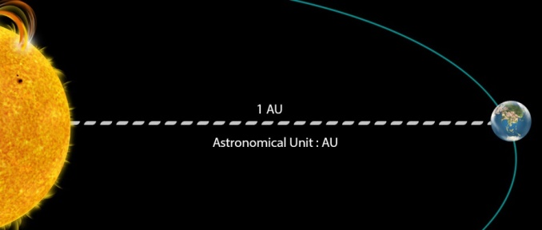
ASTRONOMICAL DISTANCE:
ASTRONOMICAL UNIT: AVG DISTANCE BETWEEN EARTH & SUN
= 150 million km

Slide 3
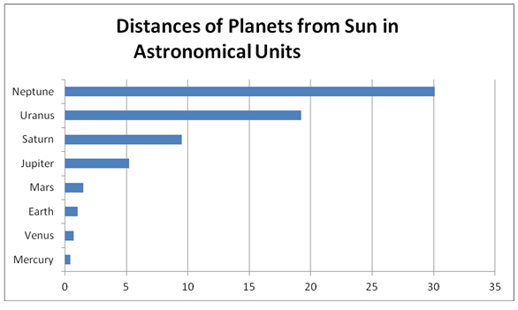

Slide 4
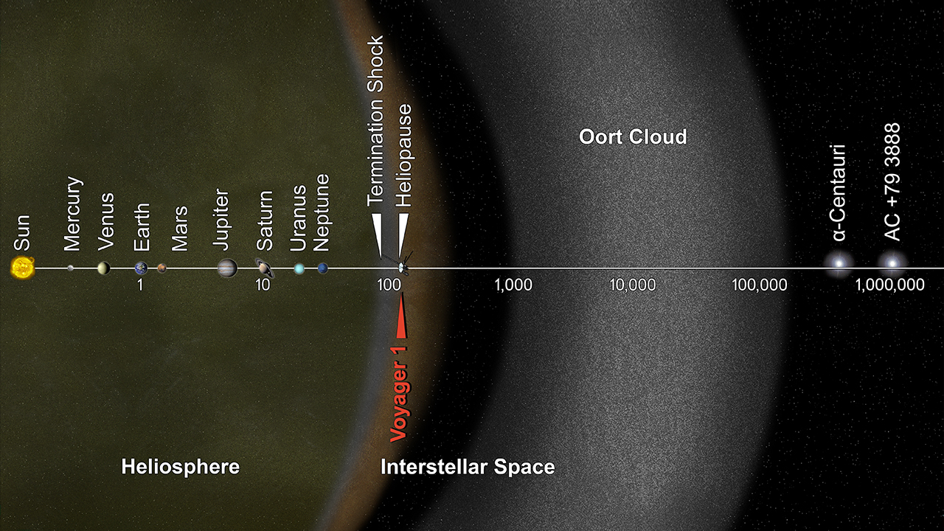

Slide 5
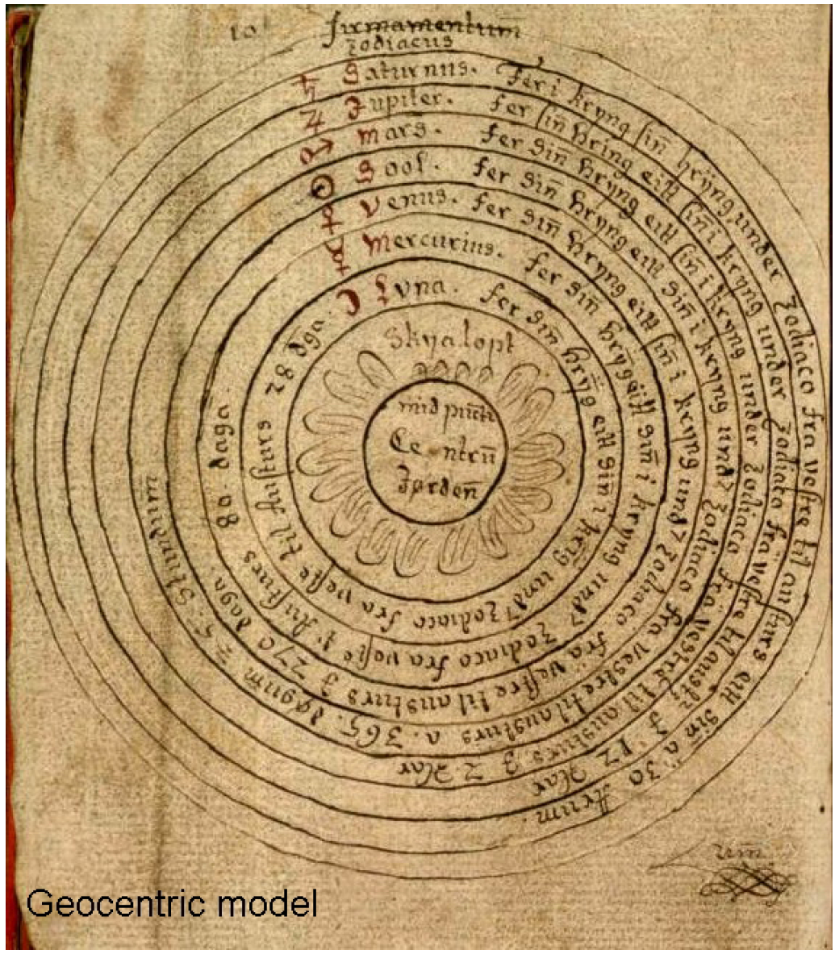
How do we measure distances?
Ancient Astronomy (Geocentric)
A large sphere with the Earth at the center; other fixed stars were attached on this large sphere. This sphere rotates once every 24 hours; the axis passes very close to the North Star. Every star revolves around the Earth in this sphere. The Sun, the Moon and other planets also move through the sky but have their own small sphere. This model is called a geocentric model, or earth centered.

Slide 6
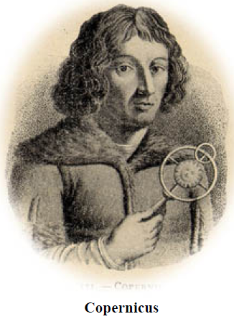
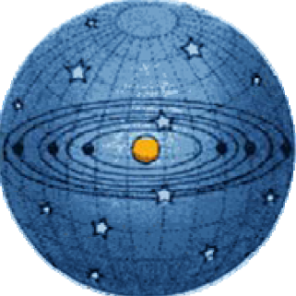
Modern astronomy:
Copernicus & Ptolemy in the early 1500s.
He had the Sun in the center of his system and other planets around it. The Earth is just only one planet orbiting around the Sun. Such a model is a heliocentric model, or sun centered.

Slide 7
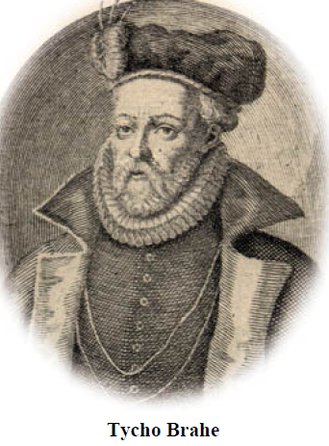
Copernicus used the circular orbits, the simple and inaccurate model. His observations then were improving by Tycho Brahe, who became the world's best pre-telescope observer, measuring the positions of planets at least ten times more accurately than ever before.

Slide 8
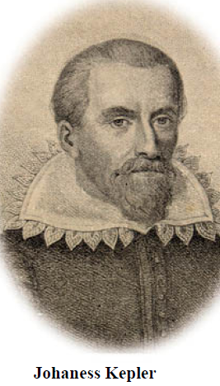
Using Tycho's position measurements, developing his own three laws, he was able to work out quite an accurate plan of the solar system. It didn't come easy. All calculations had to be done manually and it took years to explore various possible models to see if they fit observations.

Slide 9
Calculating distances using Parallax
Parallax is a displacement or difference in the apparent position of an object viewed along two different lines of sight, and is measured by the angle or semi-angle of inclination between those two lines. The term is derived from Ancient Greek (parallaxis), meaning 'alternation'.

Slide 10
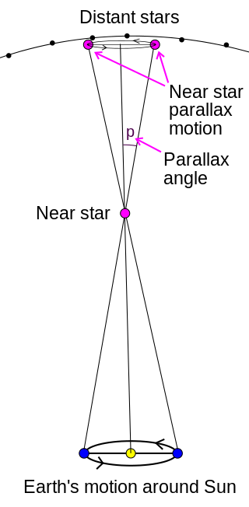
D (pc) = 1/p (arcseconds)

Slide 11
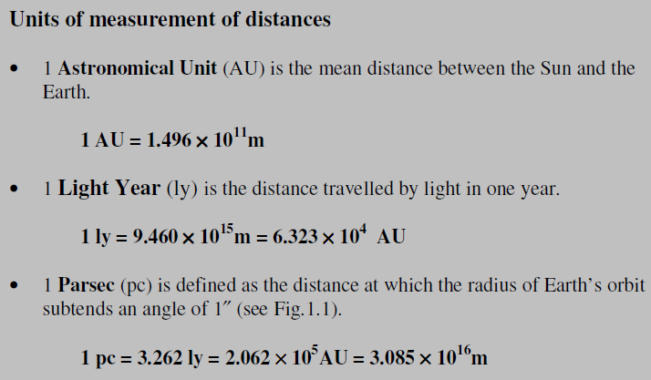

Slide 12
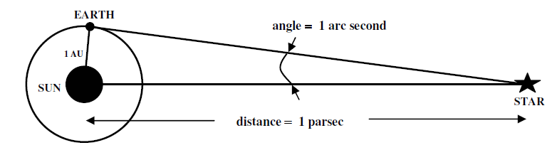
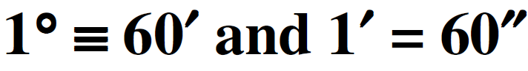
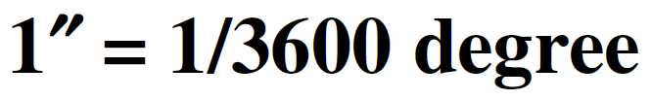
A
p
B
C

Slide 13
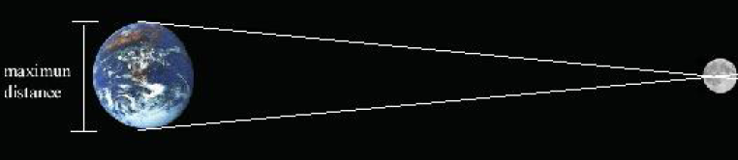
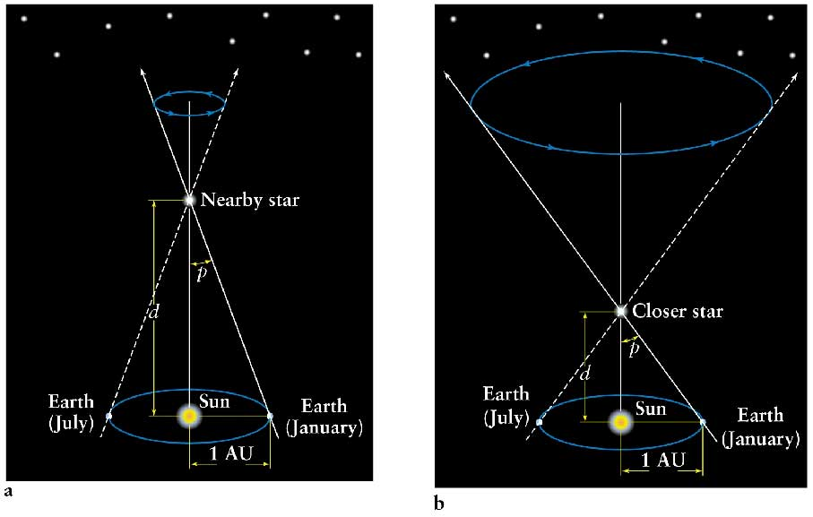

Slide 14
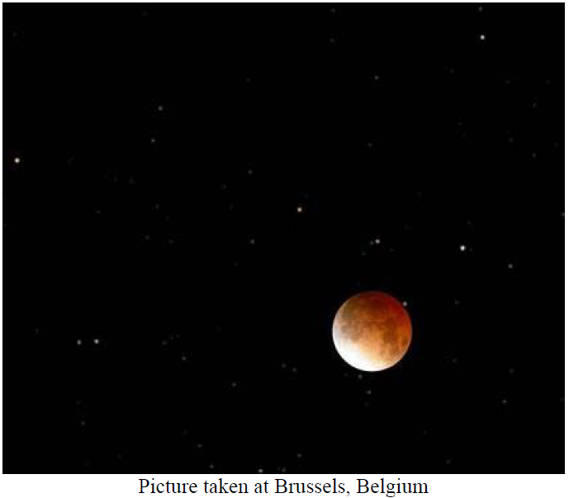
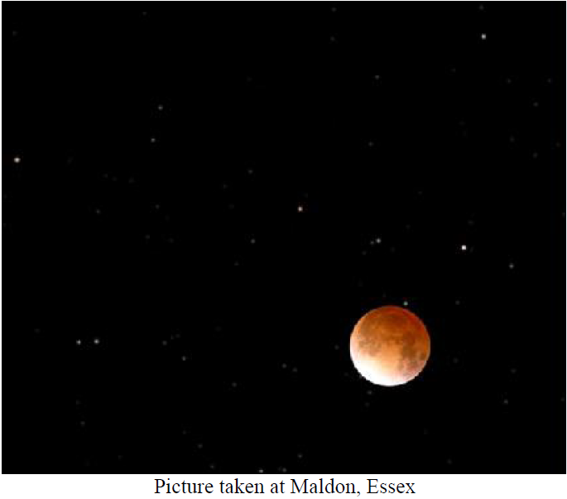
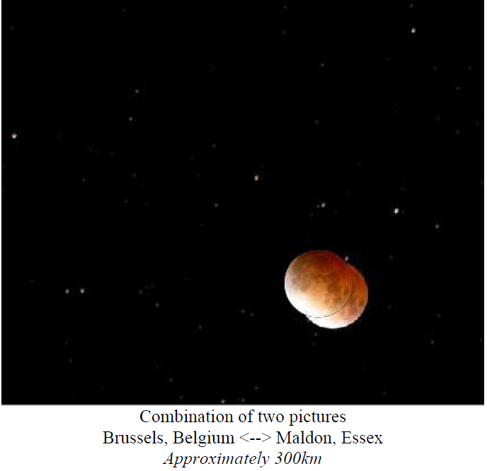

Slide 15
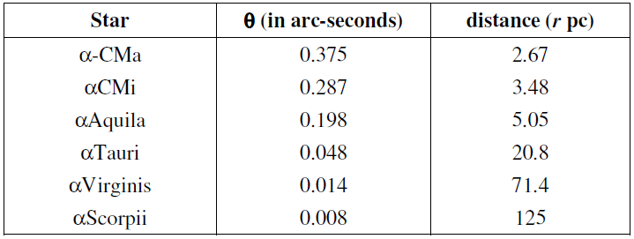

Slide 16
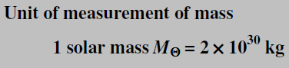
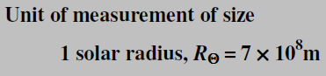
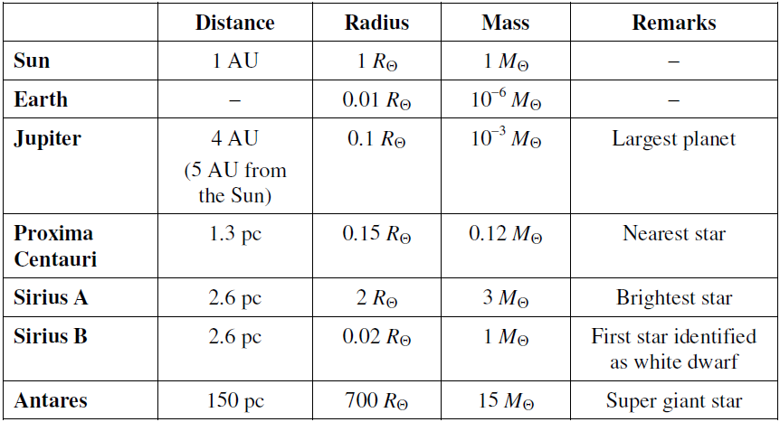
Size of astrophysical systems

Slide 17
Astronomers have discovered what may be the most massive black hole ever known in a small galaxy about 250 million light-years from Earth, scientists say. The supermassive black hole has a mass equivalent to 17 billion suns and is located inside the galaxy NGC 1277 in the constellation Perseus.

Slide 18
